Slide 1
Merge Sort
7 2 ⏐ 9 4 → 2 4 7 9
7 ⏐ 2 → 2 7
9 ⏐ 4 → 4 9
7 → 7
2 → 2
9 → 9
4 → 4
Merge Sort
Notes:
Merge Sort

Slide 2
Divide-and-Conquer
Divide-and conquer is a general algorithm design paradigm:
  Divide: divide the input data S in two disjoint subsets S₁ and S₂
  Recur: solve the subproblems associated with S₁ and S₂
  Conquer: combine the solutions for S₁ and S₂ into a solution for S
The base case for the recursion are subproblems of size 0 or 1
Merge-sort is a sorting algorithm based on the divide-and-conquer paradigm
Like heap-sort
  It has O(n log n) running time
Unlike heap-sort
  It does not use an auxiliary priority queue
  It accesses data in a sequential manner (suitable to sort data on a disk)
Merge Sort

Slide 3

Merge-Sort
Merge-sort on an input sequence S with n elements consists of three steps:
  Divide: partition S into two sequences S₁ and S₂ of about n/2 elements each
  Recur: recursively sort S₁ and S₂
  Conquer: merge S₁ and S₂ into a unique sorted sequence
Algorithm mergeSort(S)
Input sequence S with n elements
Output sequence S sorted
  according to C
  if S.size() > 1
  (S₁, S₂) ← partition(S, n/2)
  mergeSort(S₁)
  mergeSort(S₂)
  S ← merge(S₁, S₂)
Merge Sort

Slide 4
Merging Two Sorted Sequences
The conquer step of merge-sort consists of merging two sorted sequences A and B into a sorted sequence S containing the union of the elements of A and B
Merging two sorted sequences, each with n/2 elements and implemented by means of a doubly linked list, takes O(n) time
Algorithm merge(A, B)
Input sequences A and B with
n/2 elements each
Output sorted sequence of A ∪ B
  S ← empty sequence
  while ¬A.isEmpty() ∧ ¬B.isEmpty()
  if A.first().element() < B.first().element()
  S.addLast(A.remove(A.first()))
  else
  S.addLast(B.remove(B.first()))
  while ¬A.isEmpty() S.addLast(A.remove(A.first()))
  while ¬B.isEmpty() S.addLast(B.remove(B.first()))
  return S
Merge Sort

Slide 5
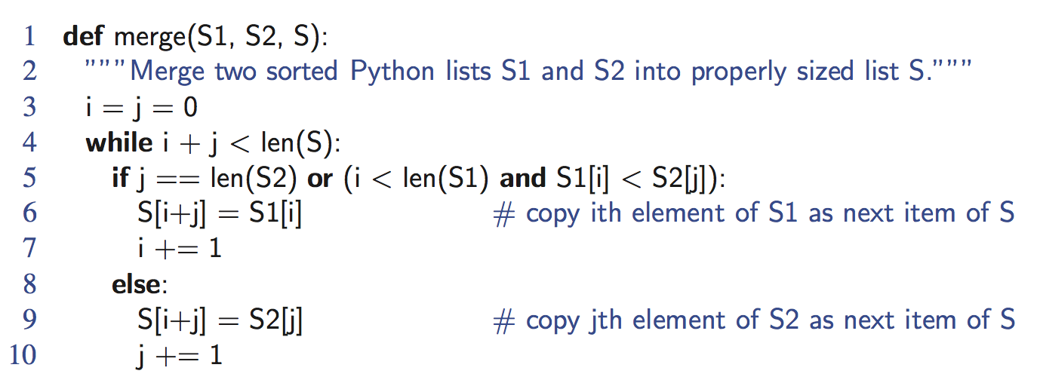
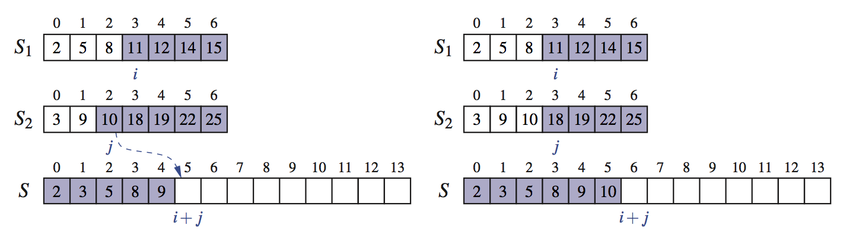
Python Merge Implementation
Merge Sort

Slide 6
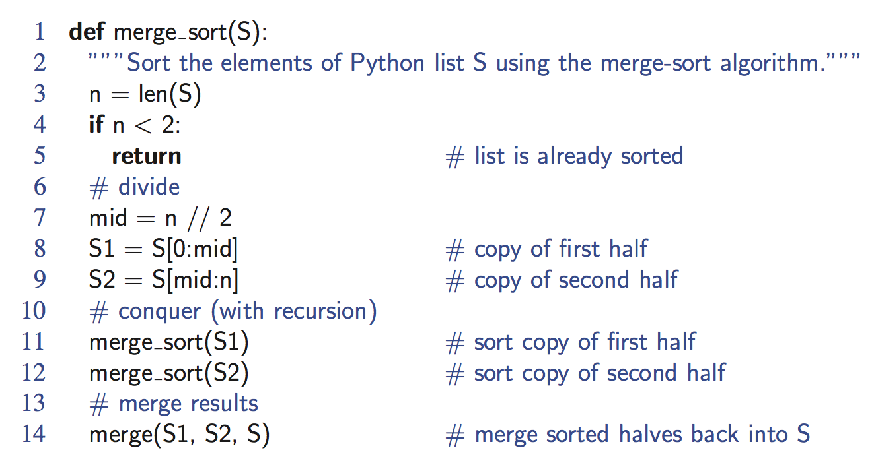
Python Merge-Sort Implementation
Merge Sort

Slide 7
Merge-Sort Tree
An execution of merge-sort is depicted by a binary tree
  each node represents a recursive call of merge-sort and stores
    unsorted sequence before the execution and its partition
    sorted sequence at the end of the execution
  the root is the initial call
  the leaves are calls on subsequences of size 0 or 1
7 2 ⏐ 9 4 → 2 4 7 9
7 ⏐ 2 → 2 7
9 ⏐ 4 → 4 9
7 → 7
2 → 2
9 → 9
4 → 4
Merge Sort

Slide 8
Execution Example
Partition
7 2 9 4 ⏐ 3 8 6 1 → 1 2 3 4 6 7 8 9
7 2 9 4 → 2 4 7 9
3 8 6 1 → 1 3 8 6
7 2 → 2 7
9 4 → 4 9
3 8 → 3 8
6 1 → 1 6
7 → 7
2 → 2
9 → 9
4 → 4
3 → 3
8 → 8
6 → 6
1 → 1
Merge Sort

Slide 9
Execution Example (cont.)
Recursive call, partition
7 2 9 4 ⏐ 3 8 6 1 → 1 2 3 4 6 7 8 9
7 2 ⏐ 9 4 → 2 4 7 9
3 8 6 1 → 1 3 8 6
7 2 → 2 7
9 4 → 4 9
3 8 → 3 8
6 1 → 1 6
7 → 7
2 → 2
9 → 9
4 → 4
3 → 3
8 → 8
6 → 6
1 → 1
Merge Sort

Slide 10
Execution Example (cont.)
Recursive call, partition
7 2 9 4 ⏐ 3 8 6 1 → 1 2 3 4 6 7 8 9
7 2 ⏐ 9 4 → 2 4 7 9
3 8 6 1 → 1 3 8 6
7 ⏐ 2 → 2 7
9 4 → 4 9
3 8 → 3 8
6 1 → 1 6
7 → 7
2 → 2
9 → 9
4 → 4
3 → 3
8 → 8
6 → 6
1 → 1
Merge Sort

Slide 11
Execution Example (cont.)
Recursive call, base case
7 2 9 4 ⏐ 3 8 6 1 → 1 2 3 4 6 7 8 9
7 2 ⏐ 9 4 → 2 4 7 9
3 8 6 1 → 1 3 8 6
7 ⏐ 2 → 2 7
9 4 → 4 9
3 8 → 3 8
6 1 → 1 6
7 → 7
2 → 2
9 → 9
4 → 4
3 → 3
8 → 8
6 → 6
1 → 1
Merge Sort

Slide 12
Execution Example (cont.)
Recursive call, base case
7 2 9 4 ⏐ 3 8 6 1 → 1 2 3 4 6 7 8 9
7 2 ⏐ 9 4 → 2 4 7 9
3 8 6 1 → 1 3 8 6
7 ⏐ 2 → 2 7
9 4 → 4 9
3 8 → 3 8
6 1 → 1 6
7 → 7
2 → 2
9 → 9
4 → 4
3 → 3
8 → 8
6 → 6
1 → 1
Merge Sort

Slide 13
Execution Example (cont.)
Merge
7 2 9 4 ⏐ 3 8 6 1 → 1 2 3 4 6 7 8 9
7 2 ⏐ 9 4 → 2 4 7 9
3 8 6 1 → 1 3 8 6
7 ⏐ 2 → 2 7
9 4 → 4 9
3 8 → 3 8
6 1 → 1 6
7 → 7
2 → 2
9 → 9
4 → 4
3 → 3
8 → 8
6 → 6
1 → 1
Merge Sort

Slide 14
Execution Example (cont.)
Recursive call, …, base case, merge
7 2 9 4 ⏐ 3 8 6 1 → 1 2 3 4 6 7 8 9
7 2 ⏐ 9 4 → 2 4 7 9
3 8 6 1 → 1 3 8 6
7 ⏐ 2 → 2 7
9 4 → 4 9
3 8 → 3 8
6 1 → 1 6
7 → 7
2 → 2
9 → 9
4 → 4
3 → 3
8 → 8
6 → 6
1 → 1
Merge Sort

Slide 15
Execution Example (cont.)
Merge
7 2 9 4 ⏐ 3 8 6 1 → 1 2 3 4 6 7 8 9
7 2 ⏐ 9 4 → 2 4 7 9
3 8 6 1 → 1 3 8 6
7 ⏐ 2 → 2 7
9 4 → 4 9
3 8 → 3 8
6 1 → 1 6
7 → 7
2 → 2
9 → 9
4 → 4
3 → 3
8 → 8
6 → 6
1 → 1
Merge Sort

Slide 16
Execution Example (cont.)
Recursive call, …, merge, merge
7 2 9 4 ⏐ 3 8 6 1 → 1 2 3 4 6 7 8 9
7 2 ⏐ 9 4 → 2 4 7 9
3 8 6 1 → 1 3 6 8
7 ⏐ 2 → 2 7
9 4 → 4 9
3 8 → 3 8
6 1 → 1 6
7 → 7
2 → 2
9 → 9
4 → 4
3 → 3
8 → 8
6 → 6
1 → 1
Merge Sort

Slide 17
Execution Example (cont.)
Merge
7 2 9 4 ⏐ 3 8 6 1 → 1 2 3 4 6 7 8 9
7 2 ⏐ 9 4 → 2 4 7 9
3 8 6 1 → 1 3 6 8
7 ⏐ 2 → 2 7
9 4 → 4 9
3 8 → 3 8
6 1 → 1 6
7 → 7
2 → 2
9 → 9
4 → 4
3 → 3
8 → 8
6 → 6
1 → 1
Merge Sort

Slide 18
Analysis of Merge-Sort
The height h of the merge-sort tree is O(log n)
  at each recursive call we divide in half the sequence,
The overall amount or work done at the nodes of depth i is O(n)
  we partition and merge 2^{i} sequences of size n/2^{i}
  we make 2^{i+1} recursive calls
Thus, the total running time of merge-sort is O(n log n)
depth | #seqs | size
0 | 1 | n
1 | 2 | n/2
i | 2^{i} | n/2^{i}
… | … | …
Merge Sort

Slide 19
Summary of Sorting Algorithms
Algorithm | Time | Notes
selection-sort | O(n²) | slow in-place for small data sets (< 1K)
insertion-sort | O(n²) | slow in-place for small data sets (< 1K)
heap-sort | O(n log n) | fast in-place for large data sets (1K — 1M)
merge-sort | O(n log n) | fast sequential data access for huge data sets (> 1M)
Merge Sort

